Slide 1

Data Structures Using C++ 2E
Chapter 1 - 4
C++ Concepts

Slide 2
Software Development Phase
Four phases
  Analysis
  Design
  Implementation
  Testing and debugging
Analysis
  First and most important step
  Analysis requirements
    Thoroughly understand the problem
    Understand the problem requirements
    Divide problem into subproblems (if complex)
Data Structures Using C++ 2E

Slide 3
Software Development Phase (cont’d.)
Design
  Design an algorithm to solve the problem or subproblem
  Algorithm
    Step-by-step problem-solving process
    Solution obtained in finite amount of time
  Structured design
    Dividing problem into smaller subproblems
    Also known as: top-down design, stepwise refinement, and modular programming
Data Structures Using C++ 2E

Slide 4
Software Development Phase (cont’d.)
Design (cont’d.)
  Object-oriented design (OOD)
    Identifies components called objects
    Determines how objects interact with one another
    Object specifications: relevant data; possible operations performed on that data
  Object-oriented programming (OOP) language
    Programming language implementing OOD
  Object-oriented design principles
    Encapsulation, inheritance, and polymorphism
Data Structures Using C++ 2E

Slide 5
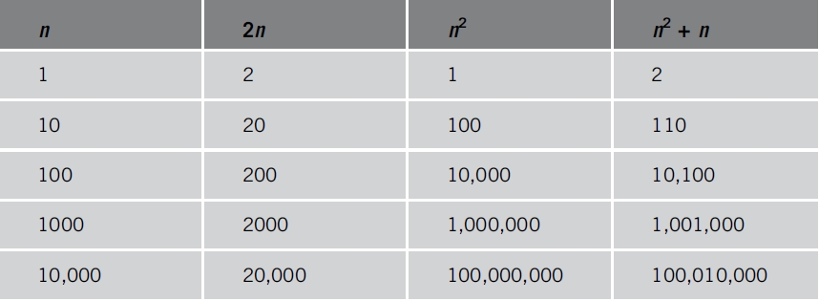
Algorithm Analysis: The Big-O Notation
Analyzing an algorithm
  Count number of operations performed
    Not affected by computer speed
TABLE 1-1 Various values of n, 2n, n², and n² + n
Data Structures Using C++ 2E

Slide 6
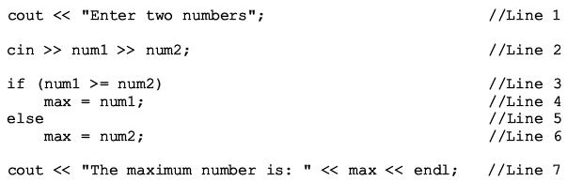
Algorithm Analysis: The Big-O Notation (cont’d.)
Example 1-1
  Illustrates fixed number of executed operations
Data Structures Using C++ 2E

Slide 7
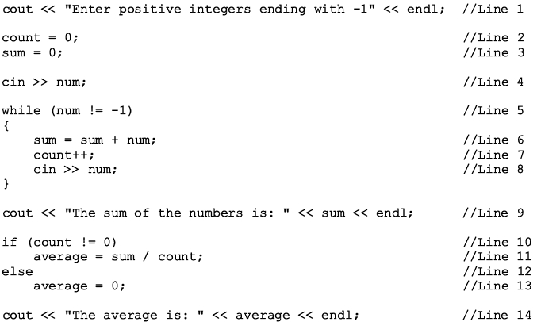
Algorithm Analysis: The Big-O Notation (cont’d.)
Example 1-2
  Illustrates dominant operations
Data Structures Using C++ 2E

Slide 8
Algorithm Analysis: The Big-O Notation (cont’d.)
Search algorithm
  n: represents list size
  f(n): count function
    Number of comparisons in search algorithm
  c: units of computer time to execute one operation
  cf(n): computer time to execute f(n) operations
  Constant c depends computer speed (varies)
  f(n): number of basic operations (constant)
  Determine algorithm efficiency
    Knowing how function f(n) grows as problem size grows
Data Structures Using C++ 2E

Slide 9
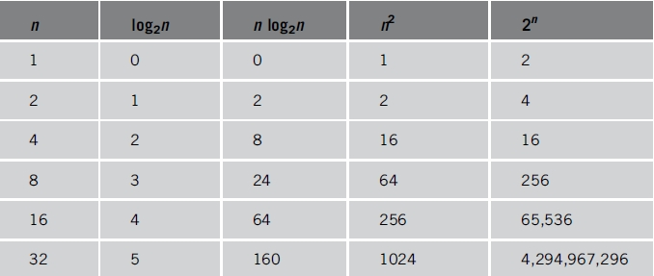
Algorithm Analysis: The Big-O Notation (cont’d.)
TABLE 1-2 Growth rates of various functions
Data Structures Using C++ 2E

Slide 10
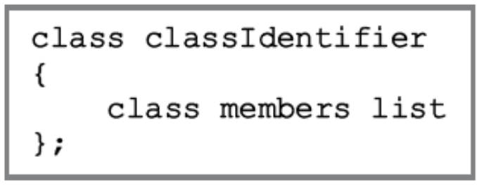
Classes
OOD first step: identify components (objects)
Encapsulation: object combines data and data operations in a single unit
Class: collection of a fixed number of components
  Class members: class components
  Class member categories
    Private, public, protected
Data Structures Using C++ 2E

Slide 11
Classes (cont’d.)
Constructors
  Declared variable not automatically initialized
  With parameters or without parameters (default constructor)
  Properties
    Constructor name equals class name
    Constructor has no type
    All class constructors have the same name
    Multiple constructors: different formal parameter lists
    Execute automatically: when class object enters its scope
    Execution: depends on values passed to class object
Data Structures Using C++ 2E

Slide 12
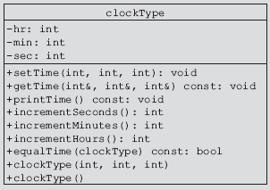
Classes (cont’d.)
Unified Modeling Language diagrams
  Graphical notation describing a class and its members
  Private and public members
FIGURE 1-5 UML class diagram of the class clockType
Data Structures Using C++ 2E

Slide 13
Structures
Structs
  Special type of classes
  All struct members public
  C++ defines structs using the reserved word struct
  If all members of a class are public, C++ programmers prefer using struct to group the members
  Defined like a class
Data Structures Using C++ 2E

Slide 14
Data Abstraction, Classes, and Abstract Data Types
Abstraction
  Separating design details from use
Data abstraction
  Process
    Separating logical data properties from implementation details
Abstract data type (ADT)
  Data type separating logical properties from implementation details
  Includes type name, domain, set of data operations
Data Structures Using C++ 2E

Slide 15
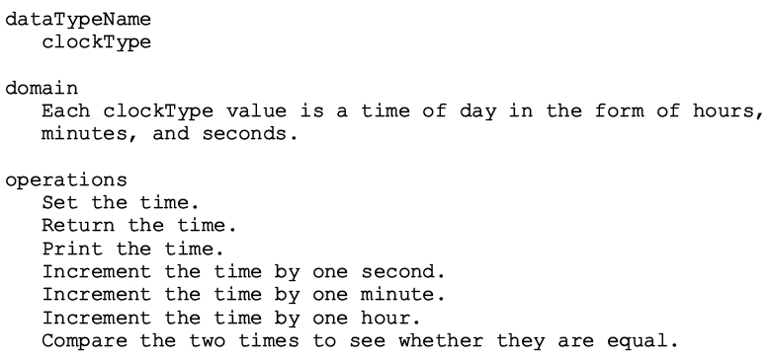
Data Abstraction, Classes, and Abstract Data Types (cont’d.)
ADT
  Example: defining the clockType ADT
Data Structures Using C++ 2E

Slide 16
Inheritance
An “is-a” relationship
  Example: “every employee is a person”
Allows new class creation from existing classes
  Base class: the existing class
  Derived class: new class created from existing classes
    Inherits base classes’ properties
    Reduces software complexity
    Becomes base class for future derived class
Inheritance types
  Single inheritance and multiple inheritance
Data Structures Using C++ 2E

Slide 17
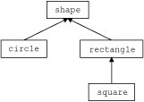
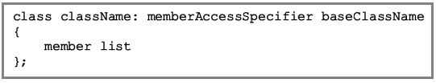
Inheritance (cont’d.)
Viewed as treelike or hierarchical
  Base class shown with its derived classes
Derived class general syntax
  No memberAccessSpecifier specified
    Assume private inheritance
FIGURE 2-1
Inheritance hierarchy
Data Structures Using C++ 2E

Slide 18
Inheritance (cont’d.)
Facts to keep in mind
  private base class members
    private to the base class
  public base class member inheritance
    public members or private members
  Derived class
    Can include additional members
    Can redefine public member base class functions
  All base class member variables
    Derived class member variables
Data Structures Using C++ 2E

Slide 19
Redefining (Overriding) Member Functions of the Base Class
Base class public member function included in a derived class
  Same name, number, and types of parameters as base class member function
Function overloading
  Same name for base class functions and derived class functions
  Different sets of parameters
Data Structures Using C++ 2E

Slide 20
Polymorphism: Operator and Function Overloading
Encapsulation
  Ability to combine data and operations
  Object-oriented design (OOD) first principle
Inheritance
  OOD second principle
  Encourages code reuse
Polymorphism
  OOD third principle
  Occurs through operator overloading and templates
    Function templates simplify template function overloading
Data Structures Using C++ 2E

Slide 21
Operator Overloading
Why operator overloading is needed
  Built-in operations on classes
    Assignment operator and member selection operator
    Other operators cannot be directly applied to class objects
  Operator overloading
    Programmer extends most operation definitions
    Relational operators, arithmetic operators, insertion operators for data output, and extraction operators for data input applied to classes
Data Structures Using C++ 2E

Slide 22
Operator Overloading (cont’d.)
Examples
  Stream insertion operator (<<), stream extraction operator(>>), +, and –
Advantage
  Operators work effectively in specific applications
C++ does not allow user to create new operators
Overload an operator
  Write functions (header and body)
  Function name overloading an operator: reserved word operator followed by operator to be overloaded
Data Structures Using C++ 2E

Slide 23
Operator Overloading (cont’d.)
Overload an operator
  Write functions (header and body)
  Function name overloading an operator: reserved word operator followed by operator to be overloaded
Example: operator >=
  Function name: operator>=
Operator function
  Function overloading an operator
Data Structures Using C++ 2E

Slide 24
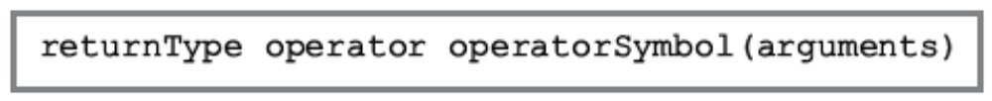
Syntax for Operator Functions
Result of an operation: value
  Operator function: value-returning function
Operator: reserved word
Overloading an operator for a class
  Include statement to declare the function to overload the operator in class definition
  Write operator function definition
Operator function heading syntax
Data Structures Using C++ 2E

Slide 25
Overloading an Operator: Some Restrictions
Cannot change operator precedence
Cannot change associativity
  Example: arithmetic operator + goes from left to right and cannot be changed
Cannot use default arguments with an overloaded operator
Cannot change number of arguments an operator takes
Data Structures Using C++ 2E

Slide 26
Overloading an Operator: Some Restrictions (cont’d.)
Cannot create new operators
Some operators cannot be overloaded
  . .* :: ?: sizeof
How an operator works with built-in types remains the same
Operators can be overloaded
  For objects of the user-defined type
  For combination of objects of the user-defined type and objects of the built-in type
Data Structures Using C++ 2E

Slide 27
The Pointer this
Sometimes necessary to refer to object as a whole
  Rather than object’s individual data members
Object's hidden pointer to itself
C++ reserved word
Available for use
When object invokes member function
  Member function references object’s pointer this
Data Structures Using C++ 2E

Slide 28
Friend Functions of Classes
A nonmember function of a class
  Has access to all class members (public or non-public)
Making function as a friend of a class
  Reserved word friend precedes function prototype (in the class definition)
Word friend appears only in function prototype in the class definition
    Not in friend function definition
Data Structures Using C++ 2E

Slide 29
Friend Functions of Classes (cont’d.)
Definition of a friend function
  Class name, scope resolution operator do not precede name of friend function in the function heading
  Word friend does not appear in friend function’s definition heading
Data Structures Using C++ 2E

Slide 30
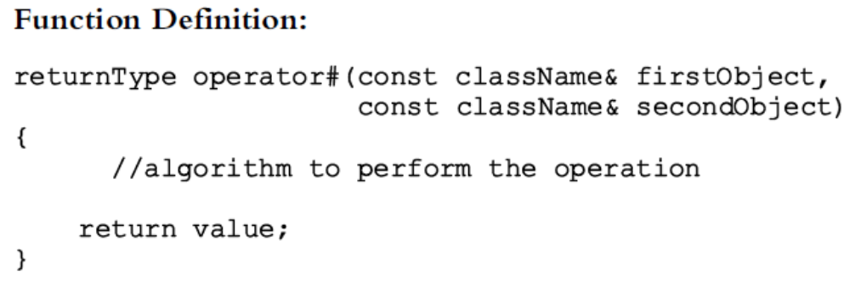
Overloading the Stream Insertion (<<) and Extraction (>>) Operators (cont’d.)
Overloading the stream extraction operator (>>)
  General syntax and function definition
Data Structures Using C++ 2E

Slide 31

Templates
Function template
  Writing a single code segment for a set of related functions
Class template
  Writing a single code segment for a set of related classes
Syntax
  Data types: parameters to templates
Data Structures Using C++ 2E

Slide 32
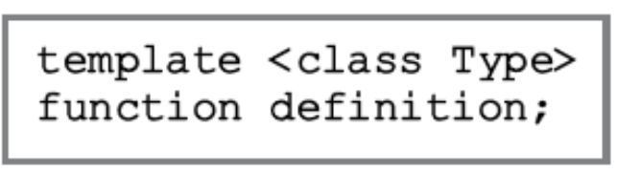
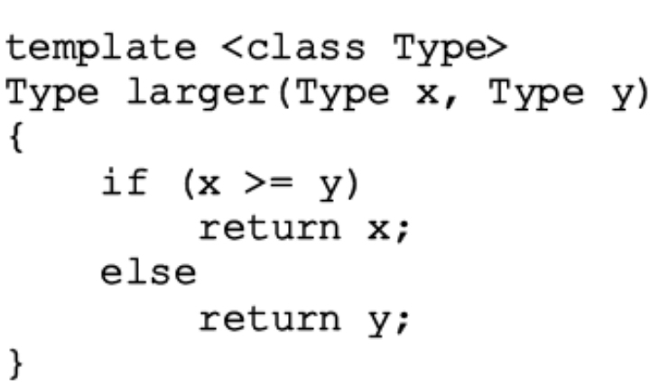
Function Templates
Simplifies process of overloading functions
Syntax and example
Data Structures Using C++ 2E

Slide 33
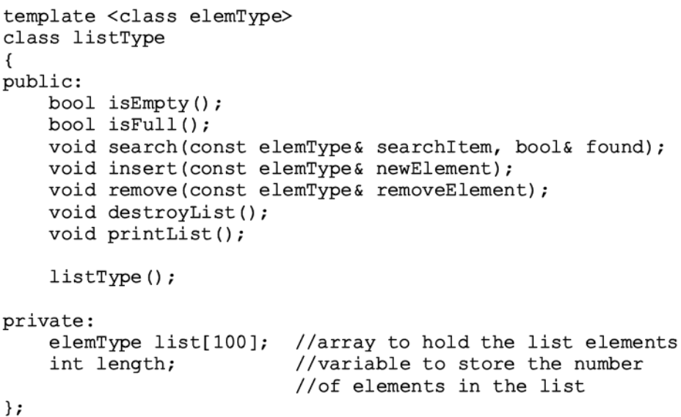
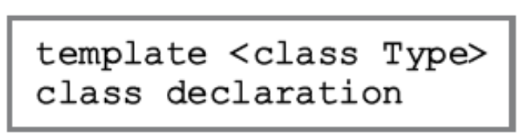
Class Templates
Used to write a single code segment for a set of related classes
Called parameterized types
  Specific class generated based on parameter type
Syntax and example
Data Structures Using C++ 2E

Slide 34
Header File and Implementation File of a Class Template
Not possible to compile implementation file independently of client code
Solution
  Put class definition and definitions of the function templates directly in client code
  Put class definition and definitions of the function templates together in same header file
  Put class definition and definitions of the functions in separate files (as usual): include directive to implementation file at end of header file
Data Structures Using C++ 2E

Slide 35
The Pointer Data Type and Pointer Variables
Pointer data types
  Values are computer memory addresses
  No associated name
  Domain consists of addresses (memory locations)
Pointer variable
  Contains an address (memory address)
Data Structures Using C++ 2E

Slide 36
The Pointer Data Type and Pointer Variables (cont’d.)
Declaring pointer variables
  Specify data type of value stored in the memory location that pointer variable points to
  General syntax
    dataType *identifier;
  Asterisk symbol (*)
    Between data type and variable name
    Can appear anywhere between the two
    Preference: attach * to variable name
  Examples: int *p; and char *ch;
Data Structures Using C++ 2E

Slide 37
The Pointer Data Type and Pointer Variables (cont’d.)
Address of operator (&)
  Unary operator
  Returns address of its operand
Dereferencing operator (*)
  Unary operator
    Different from binary multiplication operator
  Also known as indirection operator
  Refers to object where the pointer points (operand of the *)
Data Structures Using C++ 2E

Slide 38
The Pointer Data Type and Pointer Variables (cont’d.)
Pointers and classes
  Dot operator (.)
    Higher precedence than dereferencing operator (*)
  Member access operator arrow ( ->)
    Simplifies access of class or struct components via a pointer
    Consists of two consecutive symbols: hyphen and ‘‘greater than’’ symbol
  Syntax
    pointerVariableName -> classMemberName
Data Structures Using C++ 2E

Slide 39
The Pointer Data Type and Pointer Variables (cont’d.)
Initializing pointer variables
  No automatic variable initialization in C++
  Pointer variables must be initialized
    If not initialized, they do not point to anything
  Initialized using
    Constant value 0 (null pointer)
    Named constant NULL
  Number 0
    Only number directly assignable to a pointer variable
Data Structures Using C++ 2E

Slide 40
The Pointer Data Type and Pointer Variables (cont’d.)
Dynamic variables
  Variables created during program execution
    Real power of pointers
  Two operators
    new: creates dynamic variables
    delete: destroys dynamic variables
    Reserved words
Data Structures Using C++ 2E

Slide 41
Components of the STL
Program’s main objective is to manipulate data and generate results
  Requires ability to store data, access data, and manipulate data
STL components
  Containers
  Iterators: step through container elements
  Algorithms: manipulate data
Containers and iterators
  Class templates
Data Structures Using C++ 2E

Slide 42
Container Types
STL containers categories
  Sequence containers (sequential containers)
  Associative containers
  Container adapters
Data Structures Using C++ 2E

Slide 43
Sequence Containers
Every object has a specific position
Predefined sequence containers
  vector , deque , list
Sequence container vector
  Logically: same as arrays
  Processed like arrays
All containers
  Use same names for common operations
  Have specific operations
Data Structures Using C++ 2E

